Slide 1


Slide 2

N
etflix Data Analysis
Using Python libraries and Data processing's

Slide 3









Introduction
This project involves loading, cleaning, analysing, and visualizing data from a Netflix dataset. Using some crucial libraries from python to focus on the data analysis process.

Slide 4

Objectives
Import the libraries
Load the dataset
Handling the data
Implementing Exploratory Data Analysis(EDA)
Drive strategic Decision making
Scope
This project analyses the Netflix dataset using python libraries such as pandas, matplotlib to explore and gain insights from this content

Slide 5




Workflow
Data collection and Loading
Data cleaning and Transformation
Data storage and Management
Data Analysis and Insights

Slide 6
Data Collection and Loading
Data sources
The Netflix dataset contains the information of the movies and tv shows on the Netflix , directors, genres, countries, duration and ratings of the shows in it.
Data loading process
Import the panda library into python
The dataset loaded as data frame in python using the pandas data frame as pd.read_csv() function.

Slide 7
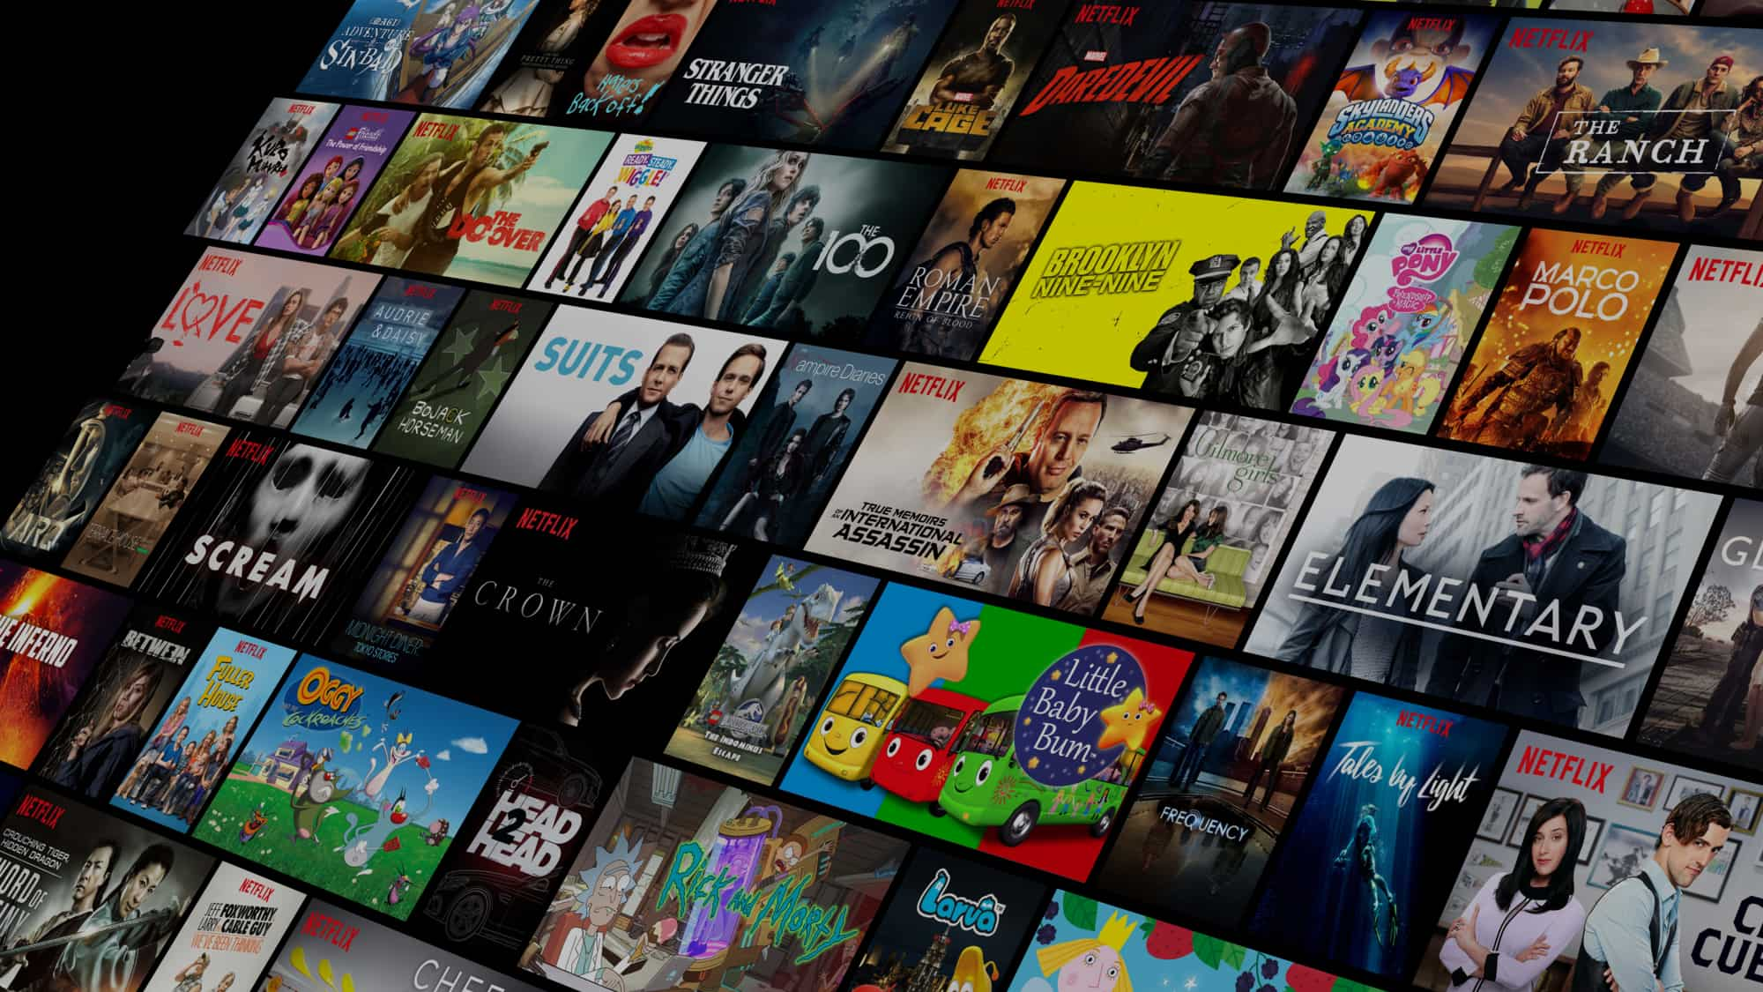
Data Cleaning
This Photo by Unknown Author is licensed under CC BY-SA

Slide 8
Improvements in Netflix Dataset
Identifying and remove the null values using the is null() function in python
Identifying and removing the duplicate values from the dataset using drop. Duplicates() function
Identifying the missing rows and drop the rows using dropna() function
Converting the data column to datetime datatype using pd.to_datatime() function in pandas.
Creating a new column if needed as per data analysis
Ensuring the data quality before proceeding to the process of visualizations and explorations.

Slide 9
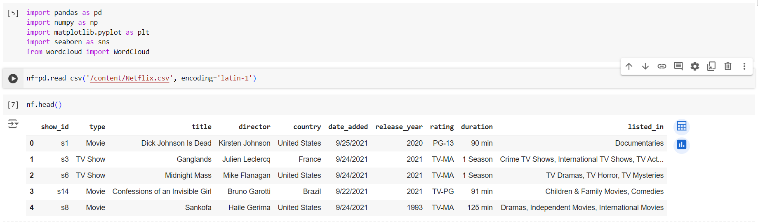
Data Loading and processing
Importing the libraries from python
Reading the Netflix dataset using the pandas function as given below
And displaying the dataset using head() function

Slide 10
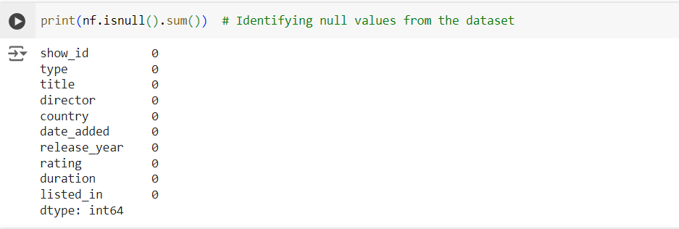
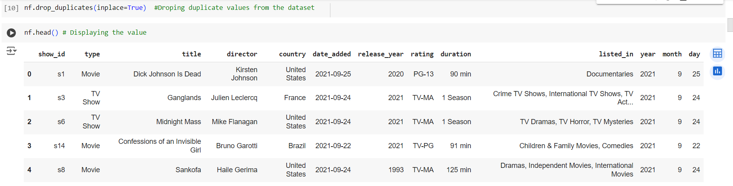
Data Cleaning
Identifying the null values from the dataset
Dropping duplicate values from the dataset
And displaying the dataset using head() function

Slide 11
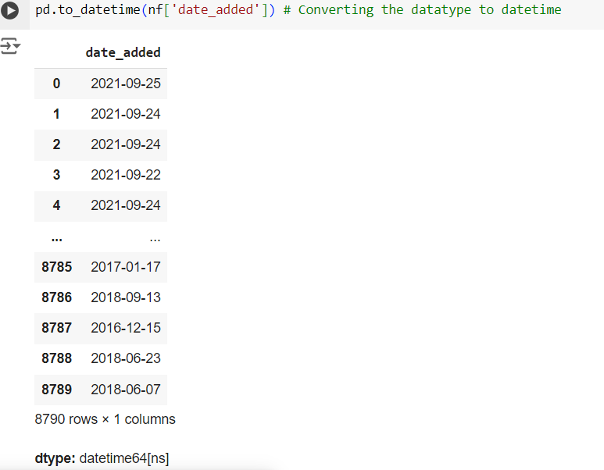
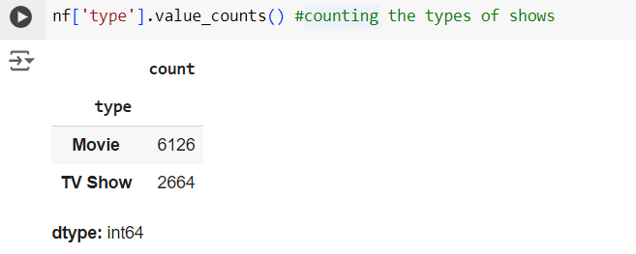
Data Cleaning
Update the date column to datetime datatype
Counting the types of shows in Netflix dataset using values_count() function

Slide 12
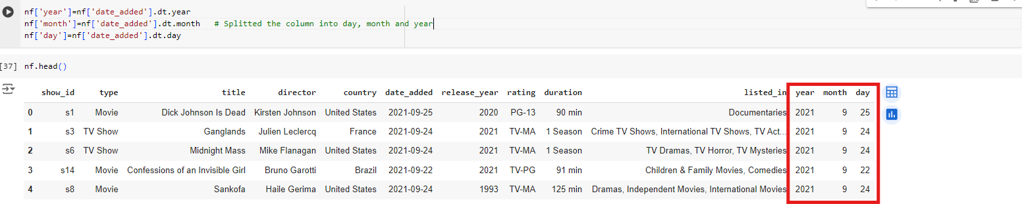
Data Cleaning
Split function is used the split column example date time is splited into day, month and year

Slide 13

Data Analysis

Slide 14
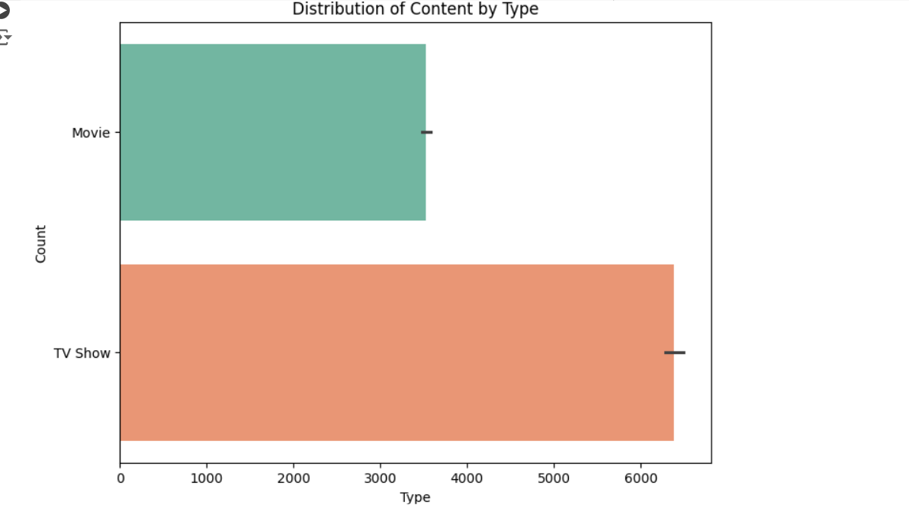
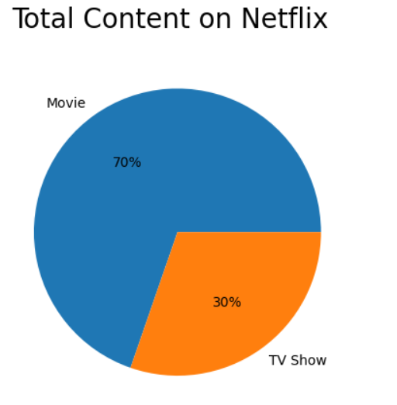
Total content on Netflix
This bar graph and pie chart shows the content type on the Netflix by counting the values on the movies and tv shows on Netflix

Slide 15
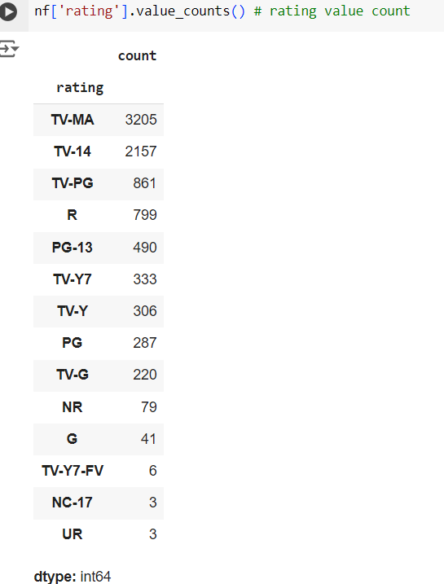
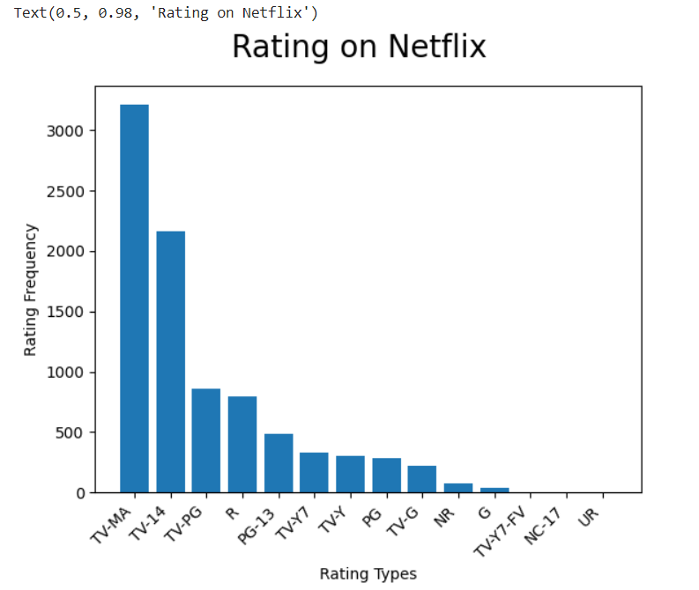
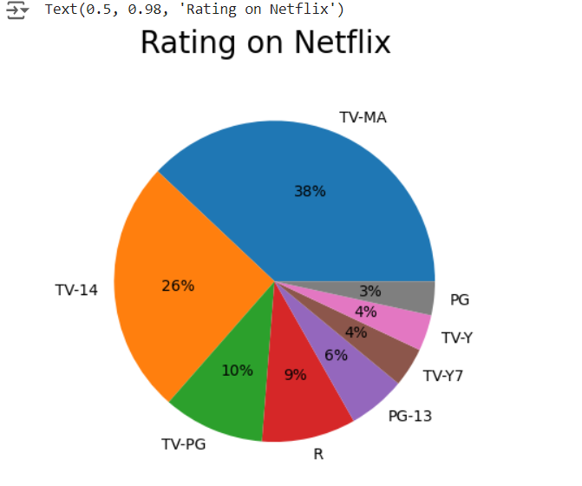
Total Rating on Netflix
This bar graph and pie chart displays the total count of rating on Netflix dataset based on the rating types.

Slide 16
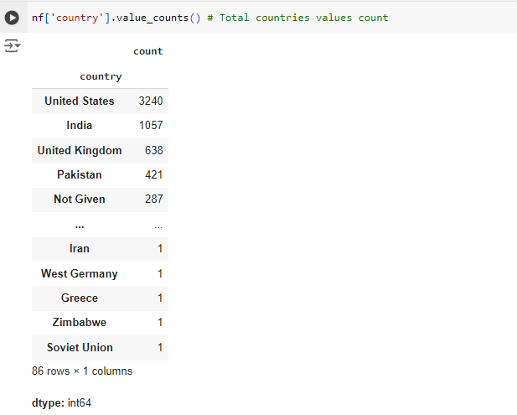
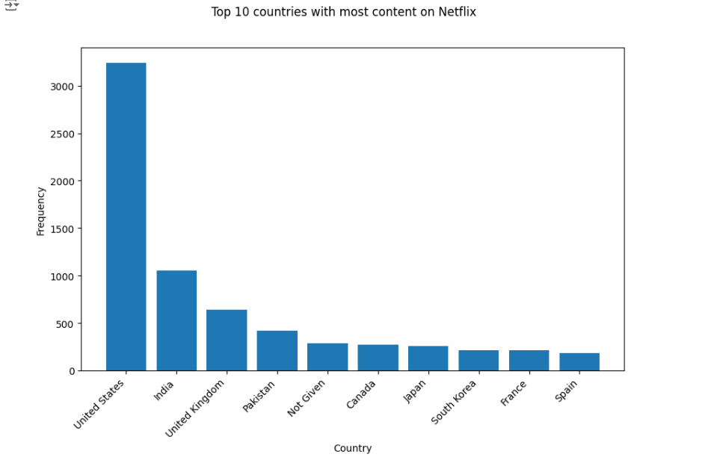
Top 10 countries with most content on Netflix
This bar graph shows the top10 countries with most content on the Netflix dataset by the countries' frequency

Slide 17
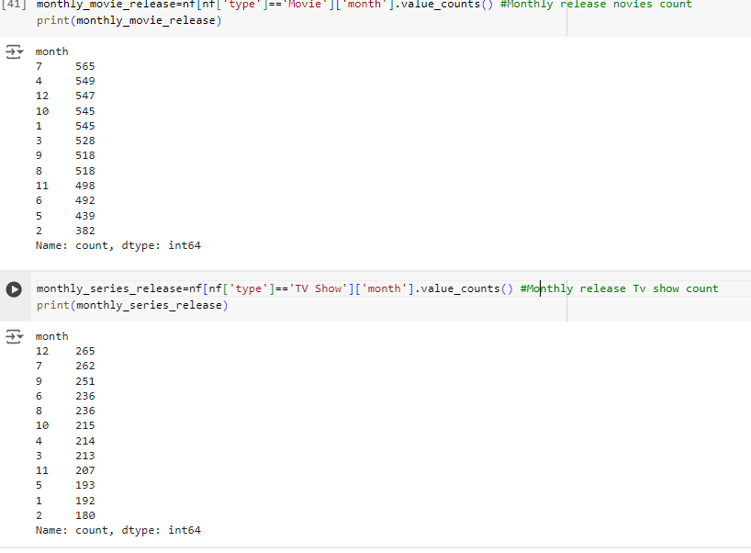
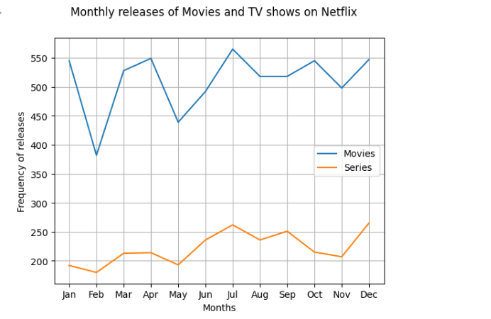
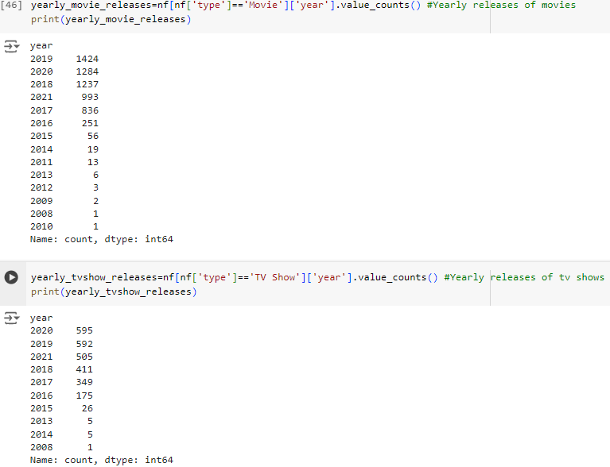
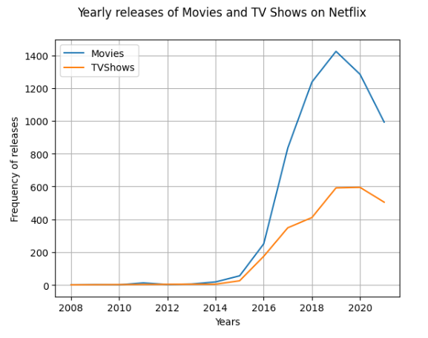
Monthly and Yearly releases of Movies and TV shows
This line graph shows the frequency of the monthly and yearly releases of movies and tv shows on Netflix.

Slide 18
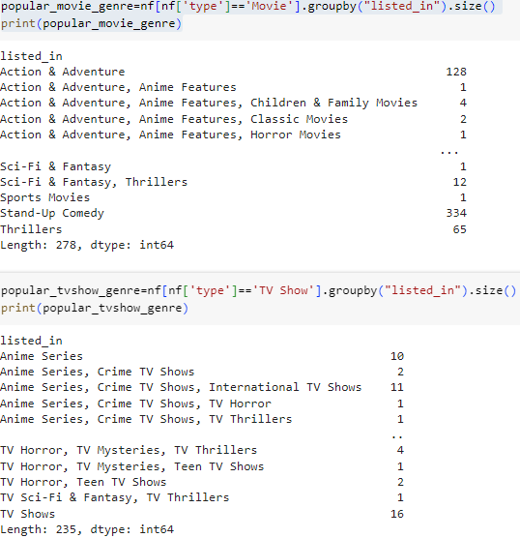
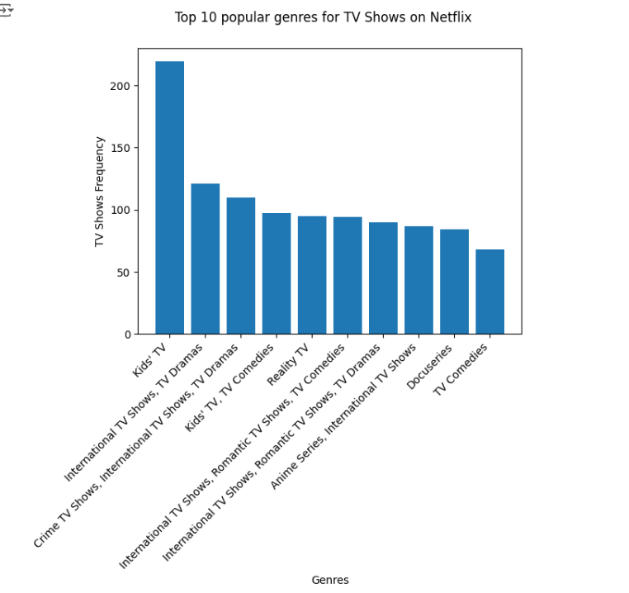
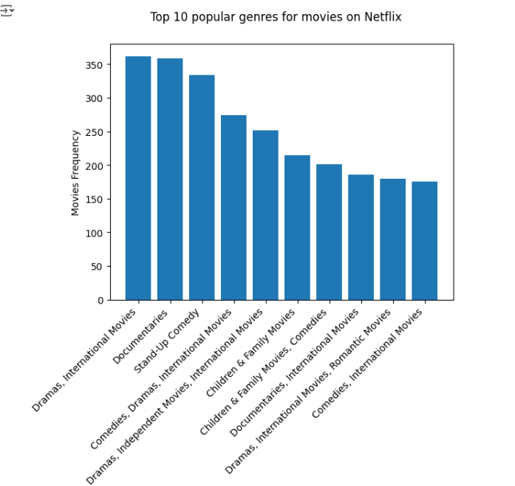
Top 10 movies and tv shows genres on Netflix
This bar graph shows the top 10 popular genres of movies and tv shows on Netflix

Slide 19
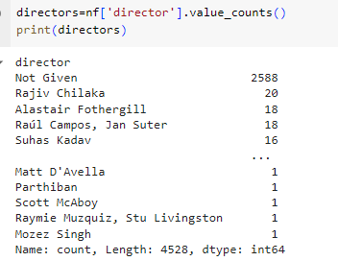
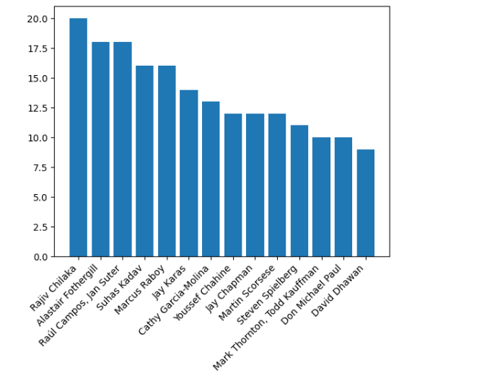
Top 15 directors with high frequency of movies and TV shows
This bar graph shows the top 15 directors with high frequency of movies and tv shows on Netflix.

Slide 20

Insights and Results

Slide 21
Key Findings
Data Structure
The Netflix dataset consist of 8790 rows and 10 columns. The columns are show id, type, title, director, country, date added, listed in , year, month , day, rating , duration, release year
Data Overview
The head() function displays the first 5 records of the dataset. And describe() function shows the description of the table of the dataset.
The shape() function shows the total rows and columns in the dataset and the size() function shows the particular column shows the total size of the records in the dataset.

